Slide 1




DATA SCIENCE
Home
About
Content
Others
IKLAN JARINGAN SOSIAL
IKLAN JARINGAN SOSIAL
By: Indasyah Ayu Andari

Slide 2




DATA SCIENCE
Home
About
Content
Others
TOOLS
USED

Slide 3
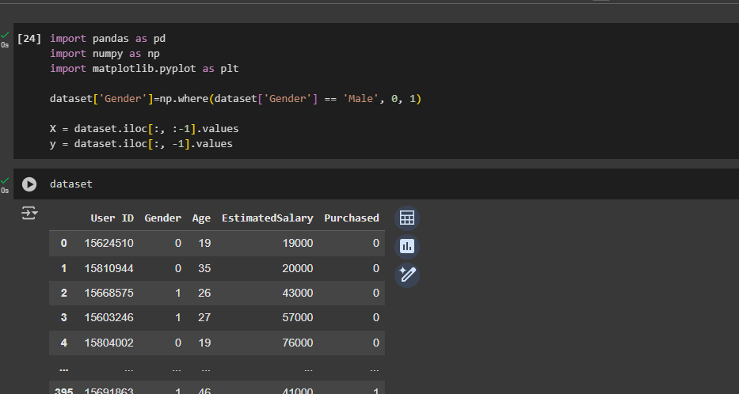
DATA SCIENCE
Home
About
Content
Others
INPUT DATA

Slide 4
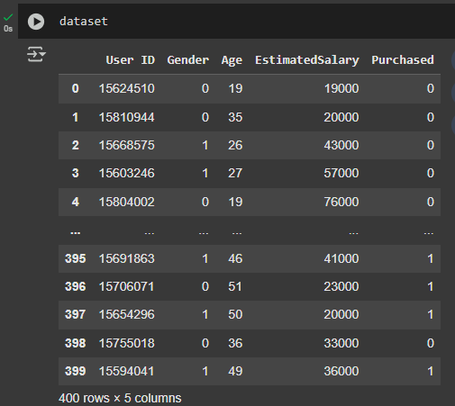
DATA SCIENCE
Home
About
Content
Others
Data
Set

Slide 5
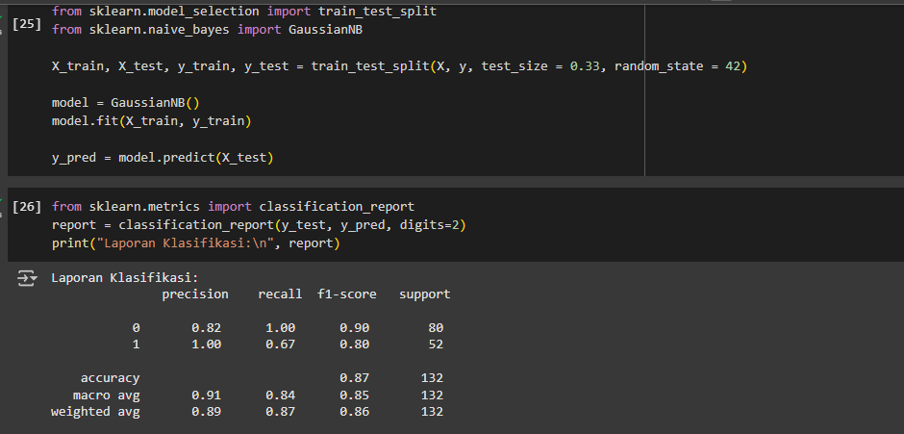
DATA SCIENCE
Home
About
Content
Others
Laporan Klasifikasi

Slide 6
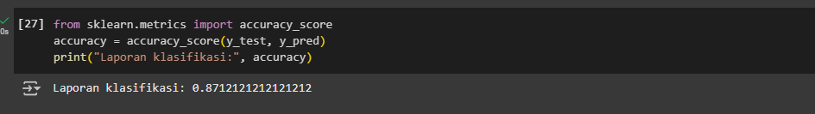
DATA SCIENCE
Home
About
Content
Others
Laporan Klasifikasi

Slide 7
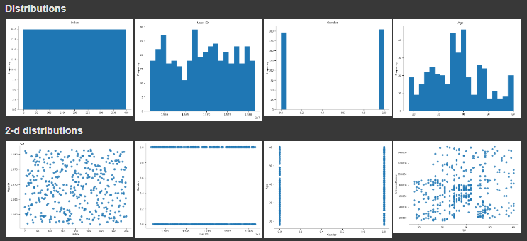
DATA SCIENCE
Home
About
Content
Others
Tabel Distribusi

Slide 8
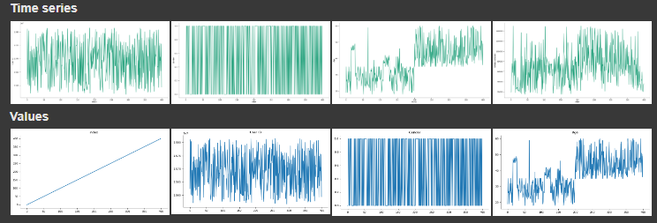
DATA SCIENCE
Home
About
Content
Others

Slide 9
DATA SCIENCE
Home
About
Content
Others
THANK YOU
THANK YOU
THANK YOU
By: Indasyah Ayu Andari

